Slide 1


First Morning: In The Beginning …
The Cosmos Within
Dr. Aileen A. O’Donoghue
July 8 – 13, 2019

Slide 2
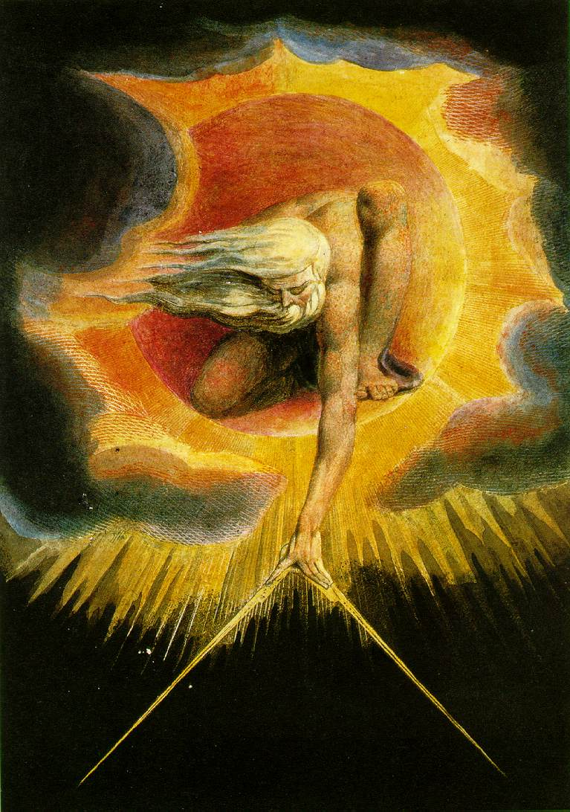
“In the beginning
when God Created
the heavens
and the Earth,
the [Universe] was a formless void and darkness covered the face of the deep”
Genesis 1:1

Slide 3
Physics Says: In the Beginning …
What Started It?
At t = 0 seconds
  Time began
  Space began
  Universe began
We Don't Know!
What DO we know?
  All galaxies are moving away from us
  More distant galaxies moving away faster
  Entire universe glows in microwaves

Slide 4
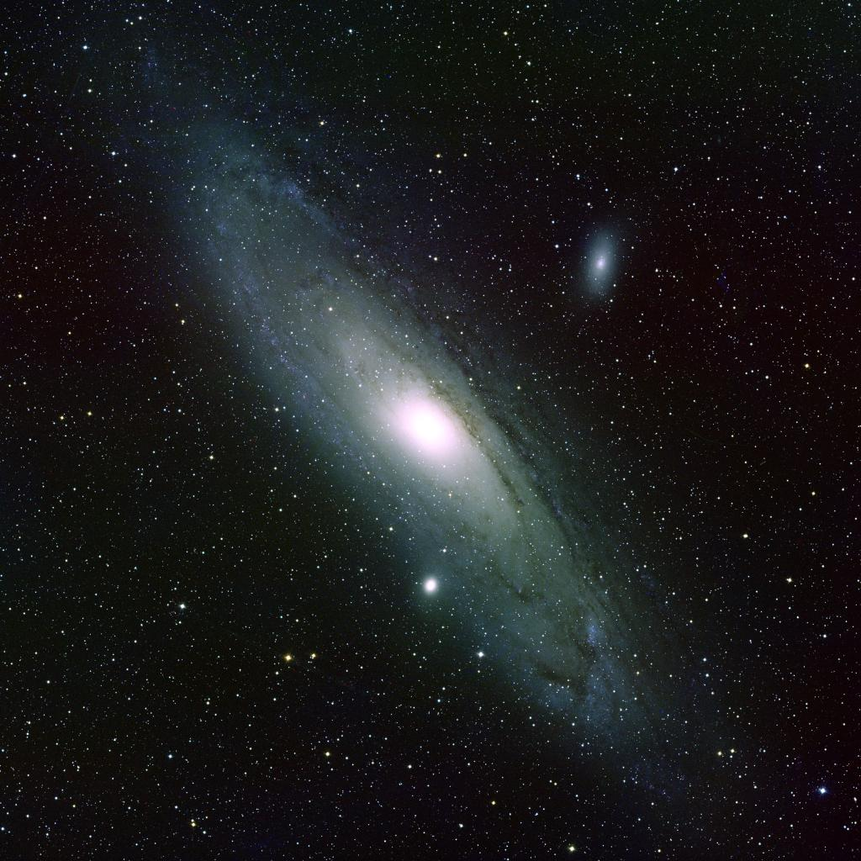
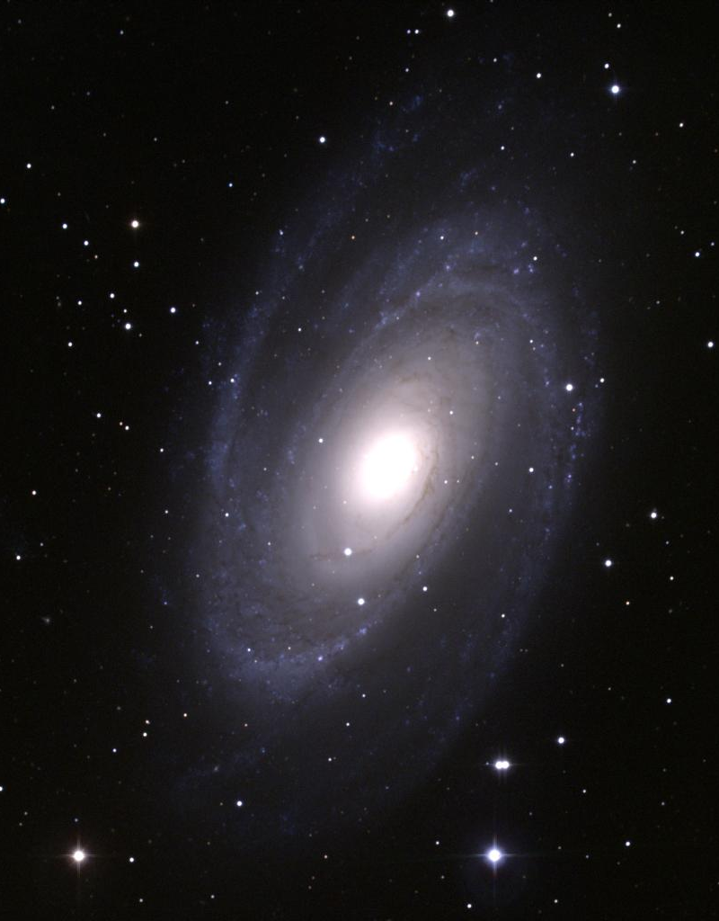
Normal Spirals (S)
Andromeda Companion M110 (NGC 205), E5/6
M81, Sb in Ursa Major
Andromeda Companion M32, E2
Andromeda Galaxy M31, Sb

Slide 5
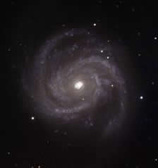
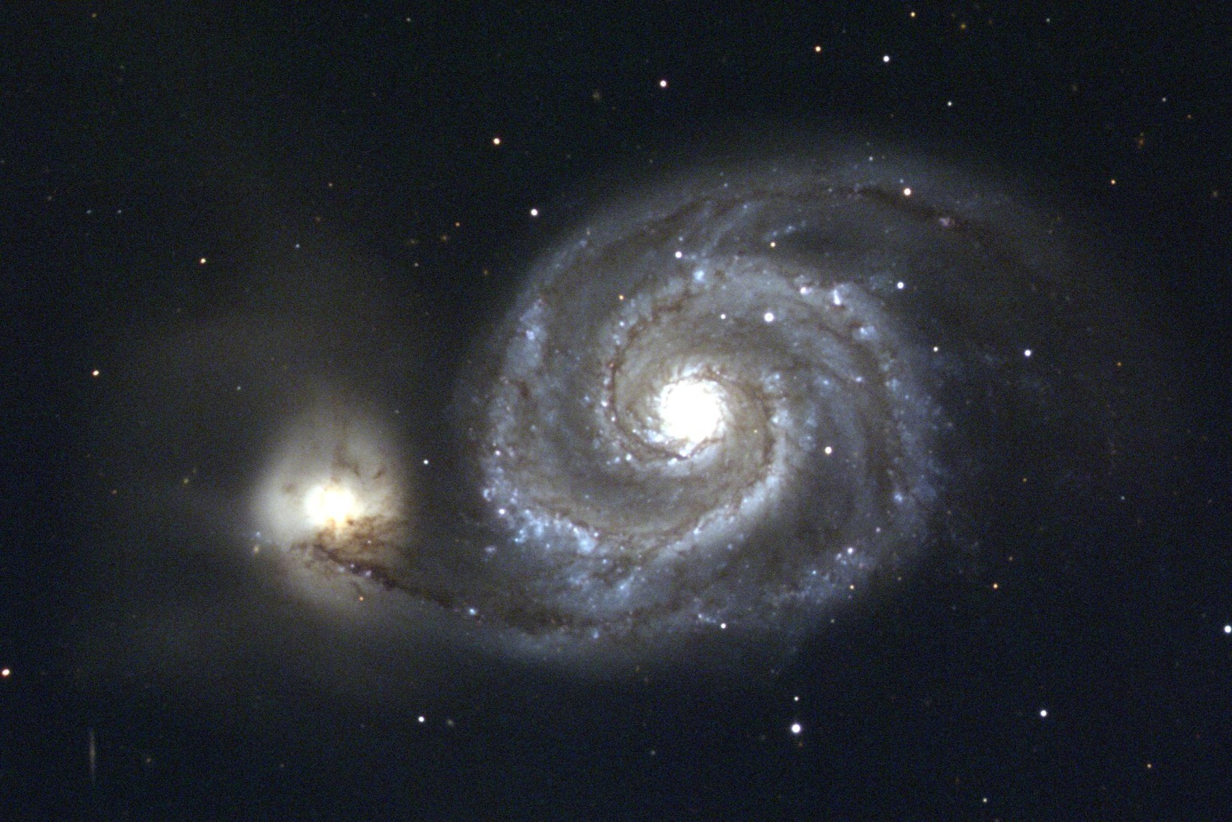
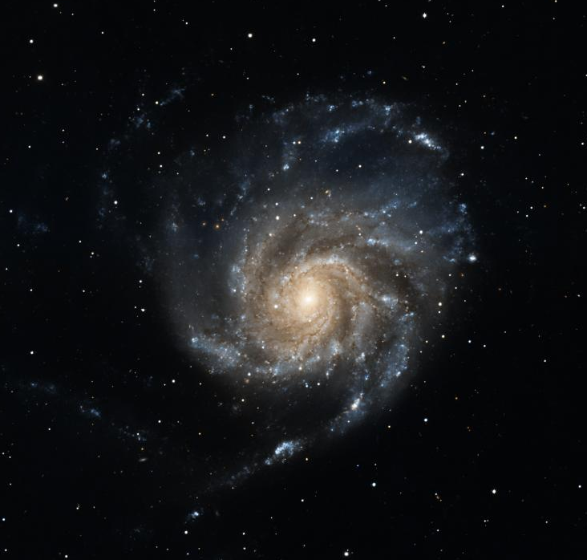
Normal Spirals (S)
M100 in Coma Berenices, Sc
M51 Companion NGC 5195, Irregular
Whirlpool Galaxy M51 in Canes Venatici, Sc
M101 in Ursa Major, Sc

Slide 6
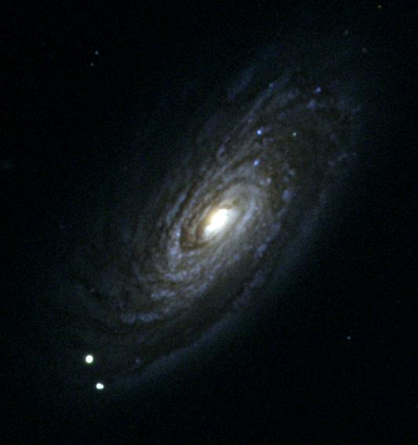
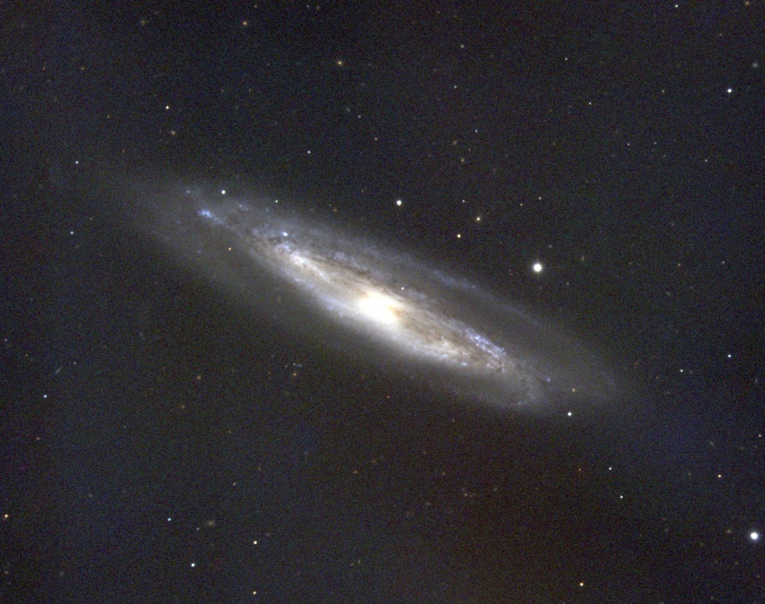
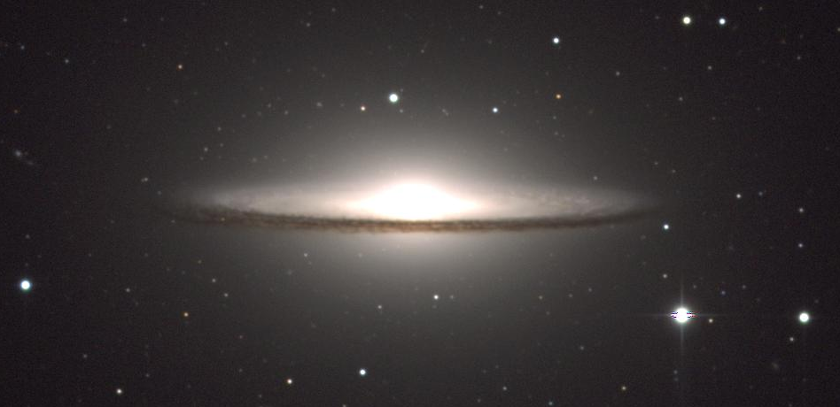
Normal Spirals (S)
M90, Sc
M98, Sb
Both in Coma Berenices
Did it recently gobble up a companion dusty dwarf galaxy?
Dust along galactic disk
Sombrero Galaxy M104 in Virgo, Sa/Sb

Slide 7
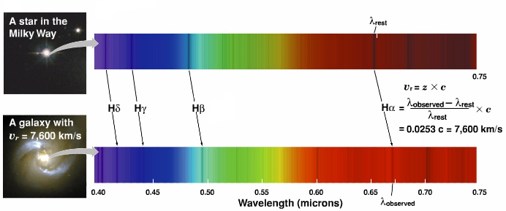
Galaxy Redshifts
Hubble discovered all galaxies show redshift
At speeds << c

Slide 8
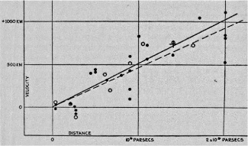
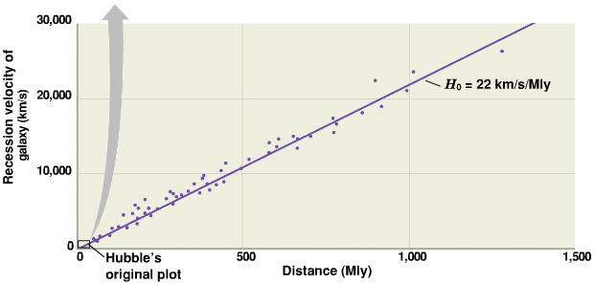
Galaxy Redshifts
More distant galaxies redshifted more
Hubble Constant = Slope of speed vs. distance curve

Slide 9

In the Beginning …
What DO we know?
  All galaxies are redshifted
  More distant galaxies redshifted more
What DOES it mean?
  All galaxies are moving away
  More distant galaxies moving away faster
Do we stink?
Yes, but the galaxies don’t care!

Slide 10




In the Beginning …
What DO we know?
  All galaxies are moving away from us
  More distant galaxies moving away faster
California Raisin Cosmology
Raisins separated by meters
-1
0
1
2
3
Distances Double in 1 sec
Singing Raisin Moves at 1 m/s
Radio Raisin Moves at 3 m/s
-2
-1
0
1
2
3
4
5
6

Slide 11
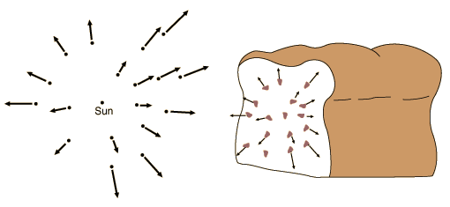
In the Beginning …
Expansion of the Universe
  All galaxies are moving away from us
  More distant galaxies moving away faster
Space, itself, is expanding!
Raisins move with dough, not through it.
Galaxies move with space, not through it!

Slide 12
In the Beginning …
Current Cosmological Theory
  Use equations to “run time backwards”
    Universe gets smaller, denser, hotter
    Can go back to ~10⁻⁴³ sec after Big Bang
Observations support Theory
  Early universe is glowing ball of energy seen as Cosmic Microwave Background
0.0000000000000000000000000000000000000000001 seconds!
… So what have we learned?

Slide 13
In The Beginning There Was …
At t=10⁻⁴³ Seconds God said
“Let there be …
LIGHT
But no sound … that was just to get your attention!
© Copyright, Dr. Aileen O’Donoghue, St. Lawrence University

Slide 14
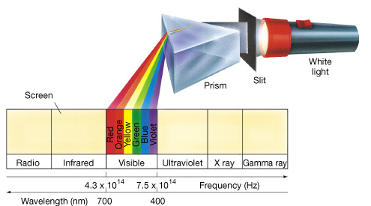
The Big Bang
After 10⁻⁴³ seconds
  Time and space began expanding
  The universe contained time, space & energy
The energy was in the form of electromagnetic radiation … light

Slide 15
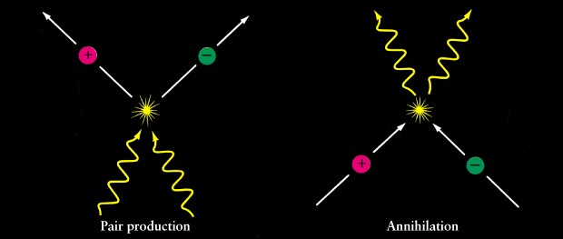
Expansion of the Universe
The Universe cooled as it expanded
  Particles condensed out of the light …
  … light and matter are the same stuff!
All matter is “frozen” energy!
Energy
is
Matter
E=mc²
Light becomes Particles …
Particles become Light …

Slide 16
Expansion of the Universe
The Universe cooled as it expanded
  Particles condensed out of the light …
  … light and matter are the same stuff!

Slide 17
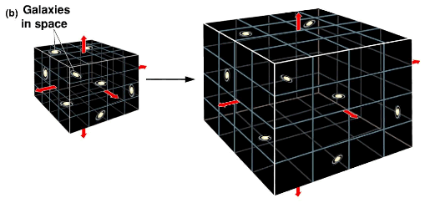
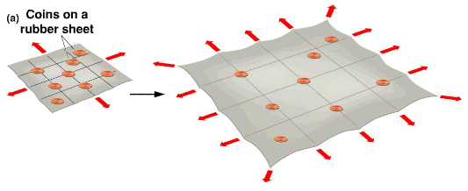
Expansion of the Universe
Space, itself, is expanding
NOT stuff expanding through space!
Coins move with sheet, not across it …
Galaxies move with space, not through it!

Slide 18
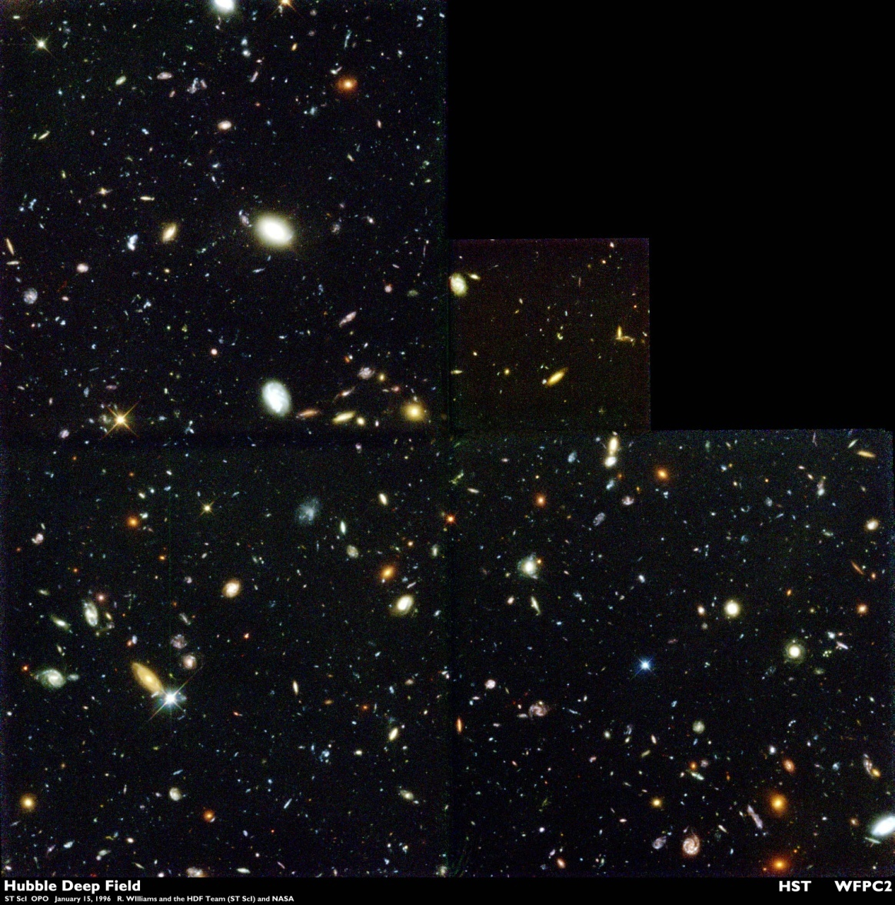
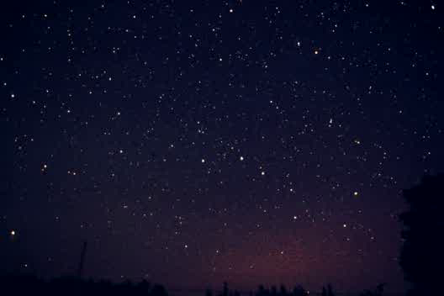
Looking Deep into the Universe
Looking out = looking back in time
  Hubble deep field
Look back to 1 billion years after the Big Bang

Slide 19
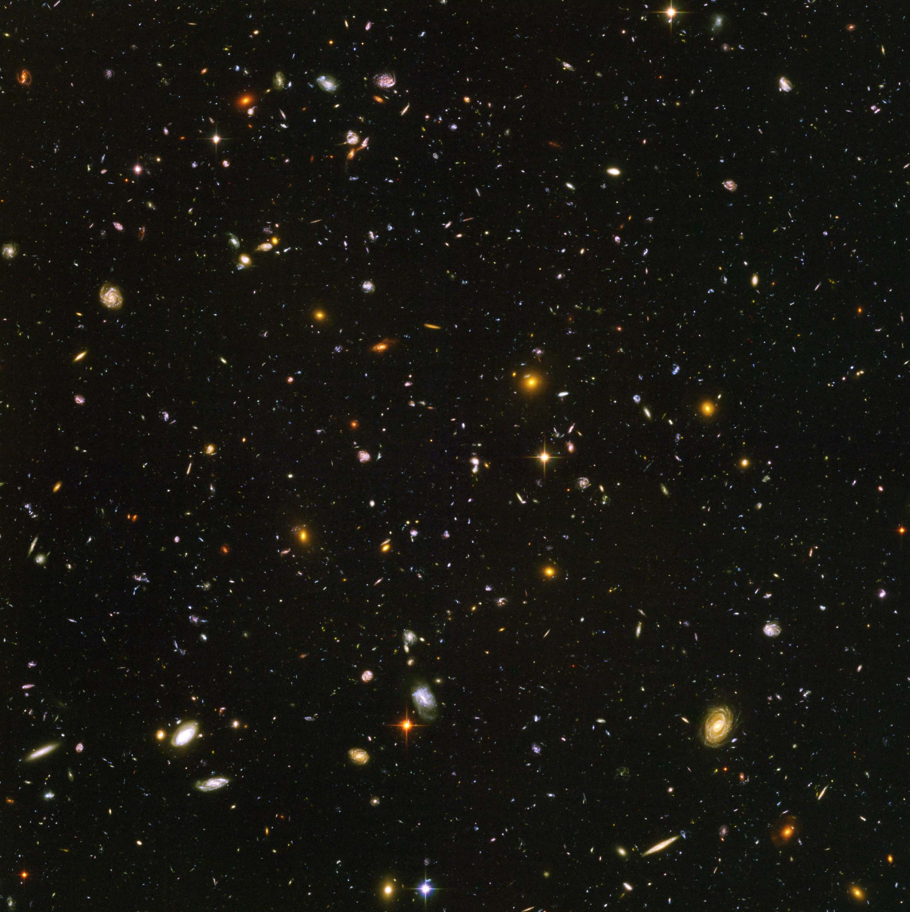
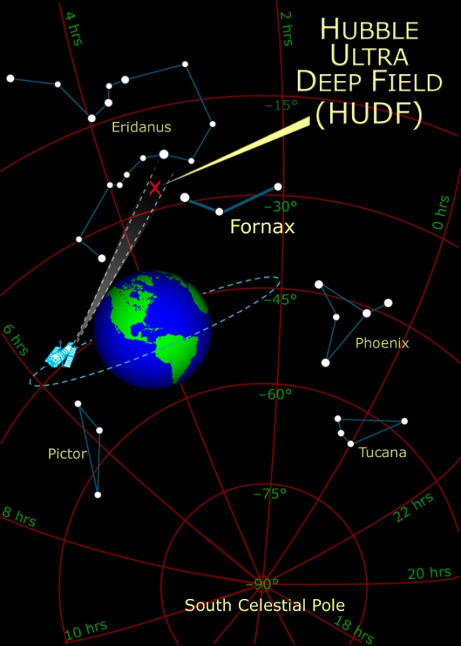
Looking Deep into the Universe
Hubble Ultra Deep Field
Deeper due to improved resolution instruments (cameras) in visble & IR

Slide 20
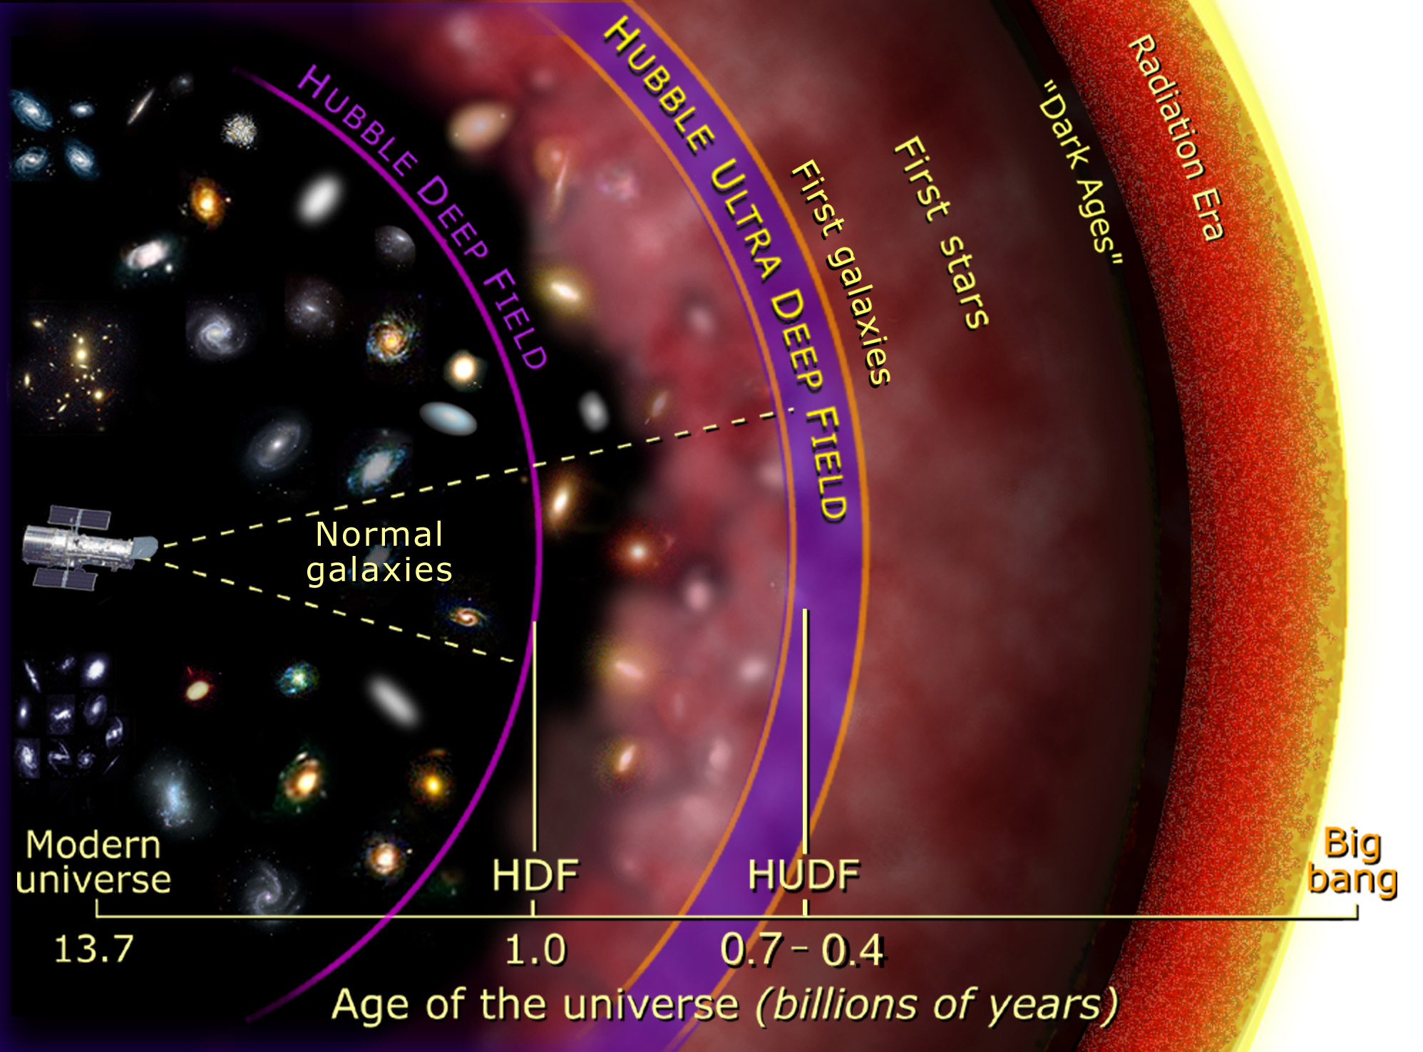
Hubble Deep Fields
Run time backwards
  density & temperature increase

Slide 21
Matter
Matter
  Quarks held together by gluons
    make protons & neutrons in atomic nuclei
  Leptons
    point-like particles without internal structure
    electrons, neutrinos, muons
Antimatter
  Just like matter with opposite charge
    Antiprotons have negative charge
    Antielectrons (positrons) have positive charge
    Annihilates with matter when they meet

Slide 22
Interactions of Matter & Energy
Four fundamental forces
  Gravity ≤ infinite, strength = 1 (weak!)
    All matter attracts all other matter
  Electromagnetic ≤ infinite, strength = 10³⁶
    All charged matter & fields attract
  Weak Nuclear ≤ 10⁻¹⁷ m, strength = 10²⁵
    Causes radioactive decay (ejects particles from nucleus)
  Strong Nuclear ≤ 10⁻¹⁵ m, strength = 10³⁸
    Holds baryons (p⁺ & nº) in nucleus

Slide 23
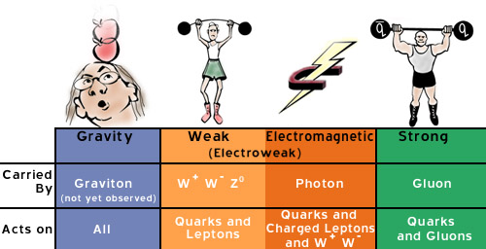
Fundamental Forces of Nature
Communicated by carrier particles:
  Gravity – gravitons
  EM – photons
  Strong –
    Gluons (hold quarks together in baryons)
    Mesons (hold baryons together)
  Weak – W⁺, W⁻, & Zº (weak boson) particles

Slide 24
Symmetry
High temperatures blurs differences
  Carrier particles transform:
  Electroweak Interaction T ≥ 10¹⁶K
    Electromagnetic & Weak act the same
    Photons ⇔ Z ⇔ Weak Bosons
  GUTs (Grand Unified Theories) T ≥ 10²⁸K
    Electroweak & Strong act the same
  Photons ⇔ X⇔ Gluons & Mesons ⇔ X⇔ Weak Bosons
  Theory of Everything (TOE) T ≥ 10³⁵K
  or Supersymmetry
    Gravity joins GUTs …
    Not yet demonstrated

Slide 25
Symmetry
Stuff of the Universe
  Matter
  Energy
  Space
  Time
Different forms of the same “stuff” matter-energy related by E = mc²
Space ~meters
Both constructs of this universe providing “grid” where matter & energy interact
1 m
1 s
time ~seconds
Space ~meters

Slide 26
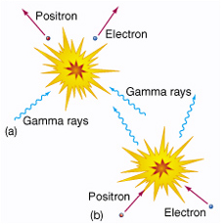
Symmetry
Big Bang
  All forces united – complete symmetry
  Quantum Foam (may exist in black holes)
    Spacetime & matter/energy indistinguishable
  Extremely hot, dense & small
    Energy and matter interchange
    “sea” of photons & particles
  Expansion & Cooling
    Breaks symmetry among forces
    Reduces energy of photons & particles

Slide 27
Symmetry
Stuff of the Universe
  Matter
  Energy
  Space
  Time
All the same stuff … “Quantum Foam”
Same as stuff in centers of black holes …
We don’t yet know its physics

Slide 28
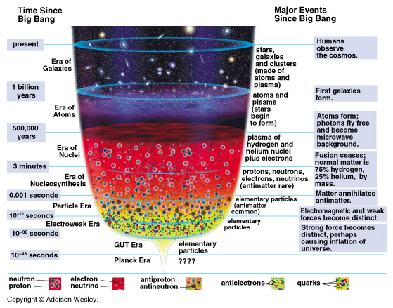
History of the Universe
Planck Era 0s to 10⁻⁴³s
  Supersymmetry … Quantum Foam
The first “tick” of the cosmic clock.
… the time it took God to say “Let there be light.”

Slide 29
History of the Universe
Planck Era 0s to 10⁻⁴³s
  Supersymmetry … Quantum Foam
GUTs 10⁻⁴³ to 10⁻³⁸s, R < 10⁻³⁴m
  EM, Strong, Weak Forces United
  Quarks, leptons arise & annihilate
    Sea of particles & energy
    Universe smaller than atomic nucleus

Slide 30
History of the Universe
Inflation ~10⁻³⁸s size expands to 3 m
  Due to separation of strong force?
  Universe gets 10⁷⁰ times larger very rapidly
  Temperature same everywhere
Electroweak Era 10⁻³⁸s to 10⁻¹⁰s
  Weak & EM force united
  Quarks no longer created (too cool!!)
  … Quark, lepton, & energy soup

Slide 31
History of the Universe
Particle Era 10⁻¹⁰s to 0.001 s, T > 10¹¹ K
  All forces separate
  Quarks bind into protons & neutrons
    1 n⁰ for each 7 p⁺ (predicted & observed!)
    Leptons still being created
  Ends with matter/antimatter annihilation
  ALL protons & neutrons made by end
All protons & neutrons in your body date from first millisecond of the universe!

Slide 32
History of the Universe
Era of Nucleosynthesis 0.001 s < t < 3 min,
T > 10¹⁰ K,
  Nuclei form from p⁺ & n⁰
    75% H, 25% He

Slide 33
History of the Universe
Era of Nuclei 3 min. to 500,000 yr, 10⁹ K – 4000K
  Sea of photons, e⁻, & nuclei
  Universe opaque
    Still a bright fog!

Slide 34
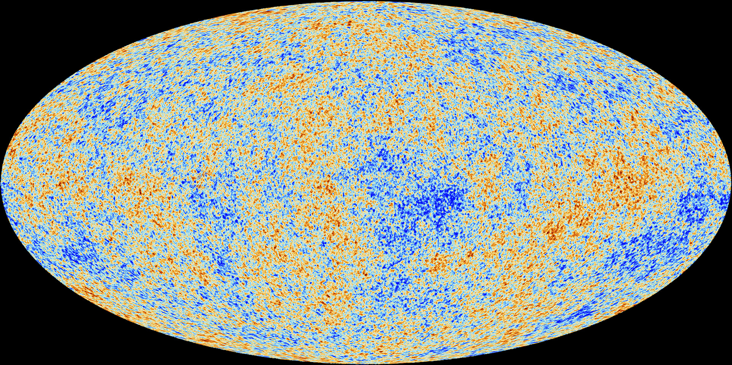
Cosmic Background Radiation
“opaque wall” at ~12-15 billion ly
  predicted and observed!
Planck
Variations over 1 part in 1,000,000
http://www.esa.int/Our_Activities/Space_Science/Planck/Planck_and_the_cosmic_microwave_background

Slide 35

Simulations of the Universe
Create computer models of universe given
  Temperature variation of CBR
    hot spots indicate gravitational collapse
    ⇒ dark matter attracting normal matter
    ⇒ shows where stars and galaxies will form
Planck
Variations over 1 part in 1,000,000

Slide 36
Millennium Simulation
Take CMB dark matter distribution
Add
  Gravity
  Time
And let it evolve …
  50 Mpc/h = 2.8 million light years
  z is a measure of time before now
    Z = 20 ⇒ beginning of time
https://wwwmpa.mpa-garching.mpg.de/galform/virgo/millennium/

Slide 37
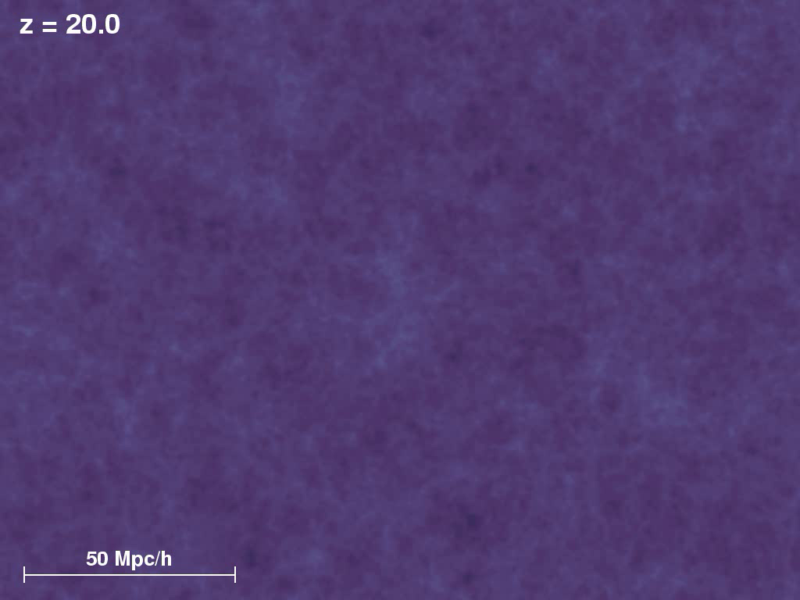
Millennium Simulation
Take CMB dark matter distribution
Add
  Gravity
  Time
And let it evolve …
  50 Mpc/h = 2.8 million light years
  z is a measure of time before now
    Z = 20 ⇒ beginning of time
https://wwwmpa.mpa-garching.mpg.de/galform/virgo/millennium/

Slide 38
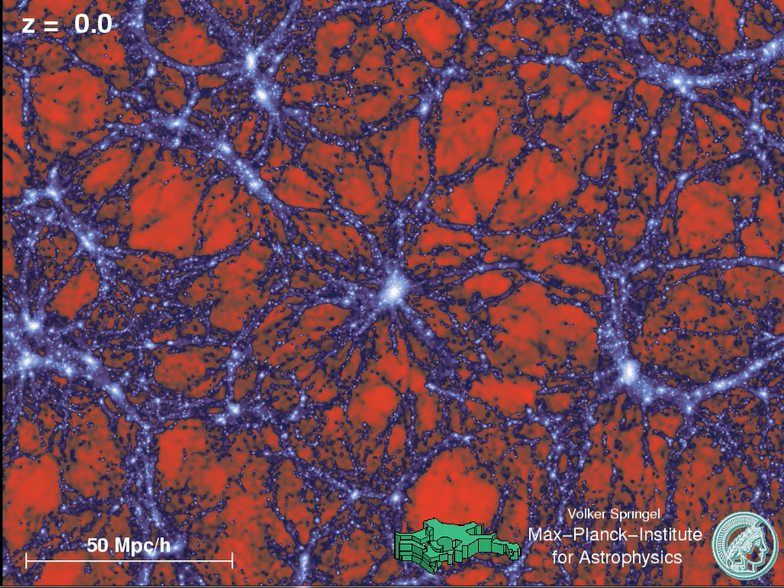
Millennium Simulation
Take CMB dark matter distribution
Add
  Gravity
  Time
And let it evolve …
  50 Mpc/h = 2.8 million light years
  z is a measure of time before now
    Z = 20 ⇒ beginning of time
Are galaxy clusters synapses in the mind of God?

Slide 39
Millennium Simulation
Take CMB dark matter distribution
Add
  Gravity
  Time
And let it evolve …
  50 Mpc/h = 2.8 million light years
  z is a measure of time before now
    Z = 20 ⇒ beginning of time
Then fly through it …
https://wwwmpa.mpa-garching.mpg.de/galform/virgo/millennium/

Slide 40
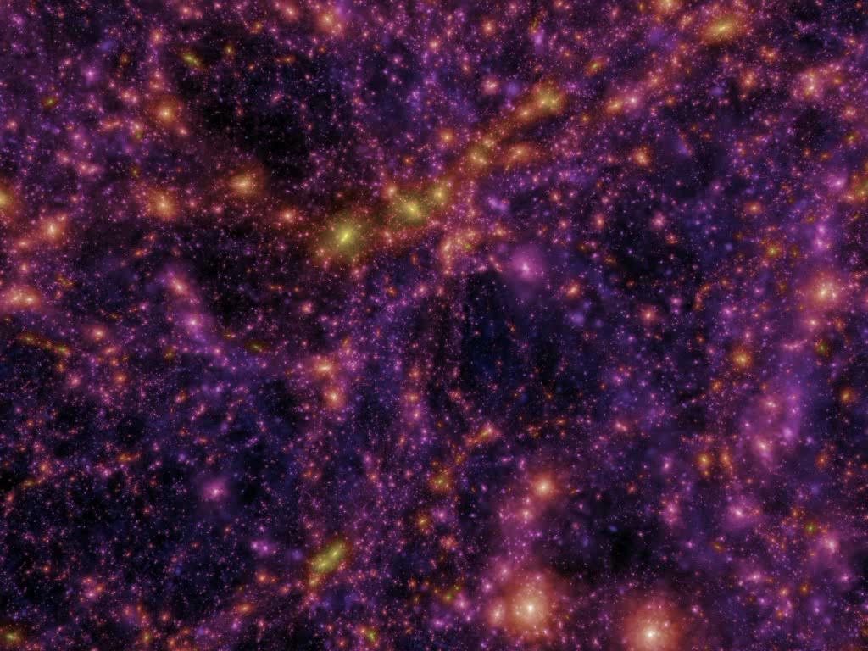
Millennium Simulation
Take CMB dark matter distribution
Add
  Gravity
  Time
And let it evolve …
  50 Mpc/h = 2.8 million light years
  z is a measure of time before now
    Z = 20 ⇒ beginning of time
Then fly through it …
https://wwwmpa.mpa-garching.mpg.de/galform/virgo/millennium/

Slide 41
The Wisdom of Solomon
“The Lord created me at the beginning of his work,
The first of his acts of long ago.
Ages ago I was set up, at the first, before the beginning of the Earth.
When he established the heavens, I was there.”
.
.
.
Proverbs 8:22-23, 27

Slide 42
Richard Rohr
If we see the Eternal Christ Mystery as the symbolic Alpha Point for the beginning of “time,” we can see that history and evolution indeed have an intelligence, a plan, and a trajectory from the very start.
- Daily Meditations 3/10/10

Slide 43
Ilia Delio
Teilhard indicated that in the [first] incarnation, the “self” of God is in the “self-emptying” of God. God is that which is constantly becoming “element,” drawing all things through love into fullness of being. … The universe is physically impregnated to the very core of its matter by the influence of this divine nature.
- RR. Daily Meditations 2/22/10

Slide 44
Physicality
The protons and neutrons in every atom that you are made of was created in the first 10th of a millisecond after the Big Bang began
Start trying to feel your physicality and its deep connection to the beginning of the Universe and God’s

Slide 45
Let there be …
LIGHT
© Copyright, Dr. Aileen O’Donoghue, St. Lawrence University

